Slide 1
Global Electric Cars Analysis
Presenters: Jun Jiang, Anjila Ghimire

Slide 2
Table of Content
Introduction of Electric Cars
Data Exploration
Analysis Page
Conclusion
References

Slide 3

Introduction of Electric Cars
An electric car is a vehicle that uses an electric motor instead of a gasoline or diesel engine to power it. There are several types of electric cars, including:
Bacterry Electric Vehicles (BEV)
Plug-In Hybrid Electric Vehicles (PHEVs)
Fuel Cell Electric Vehicles (FCEV)
What are the top countries with the highest electric vehicle sales and does the availability of charging infrastructure affect the adoption rate of electric vehicles?
Which type of electric vehicles are sold the most across the world and is battery electric make up the most part of the global electric vehicle market share?

Slide 4
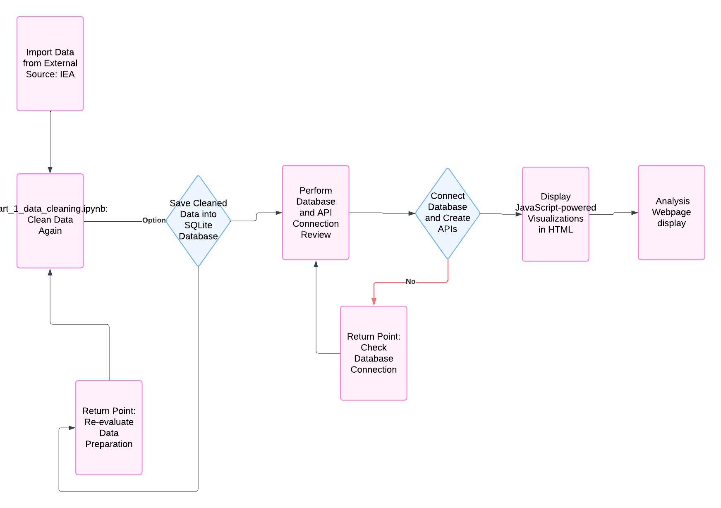
Data Exploration
Data source: IEA the Global EV Outlook 2024
The International Energy Agency (IEA) works with governments and industry to shape a secure and sustainable energy future for all
We capture all electric cars sales data and charging points for 52 countries from 2010 up to year 2024.
The projection data is based on the Announced Pledges Scenario (APS) for major regions including China, EU, India, USA, and the Rest of the world from 2025 to 2035.

Slide 5
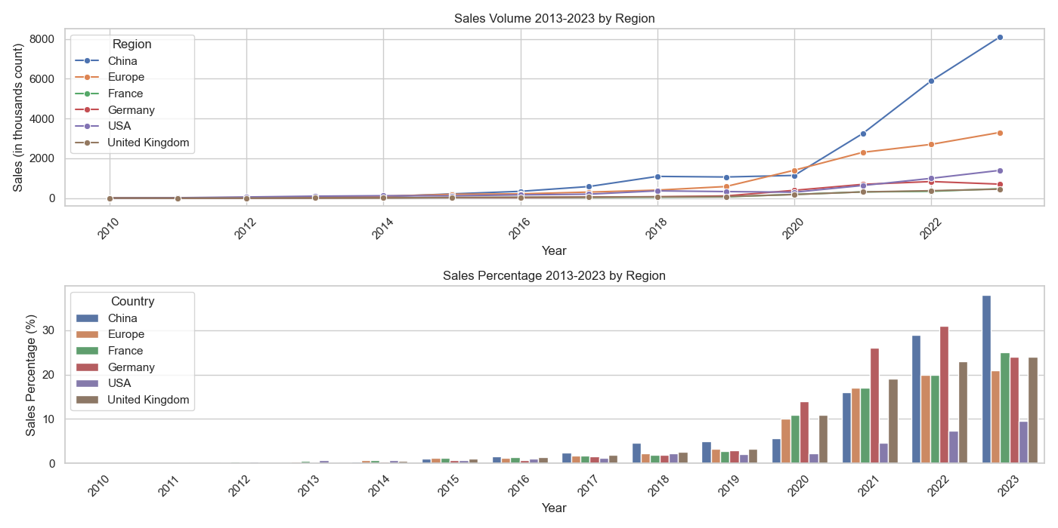
Analysis Page
selected_regions:'China', 'Europe', 'USA', 'Germany', 'France', 'United Kingdom'

Slide 6
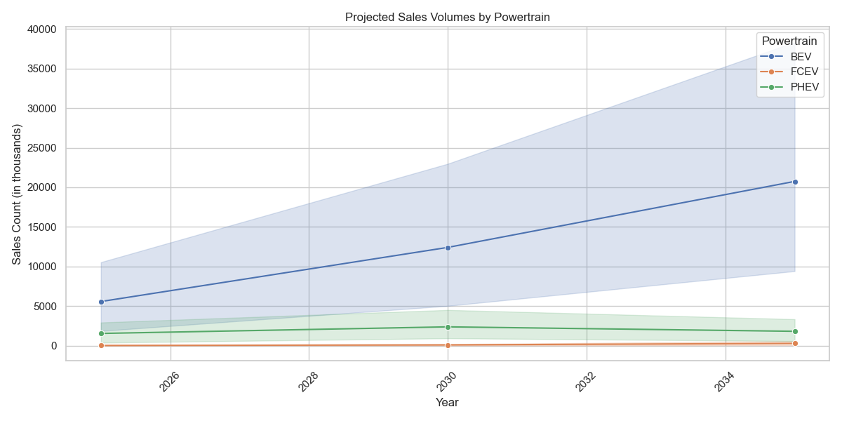
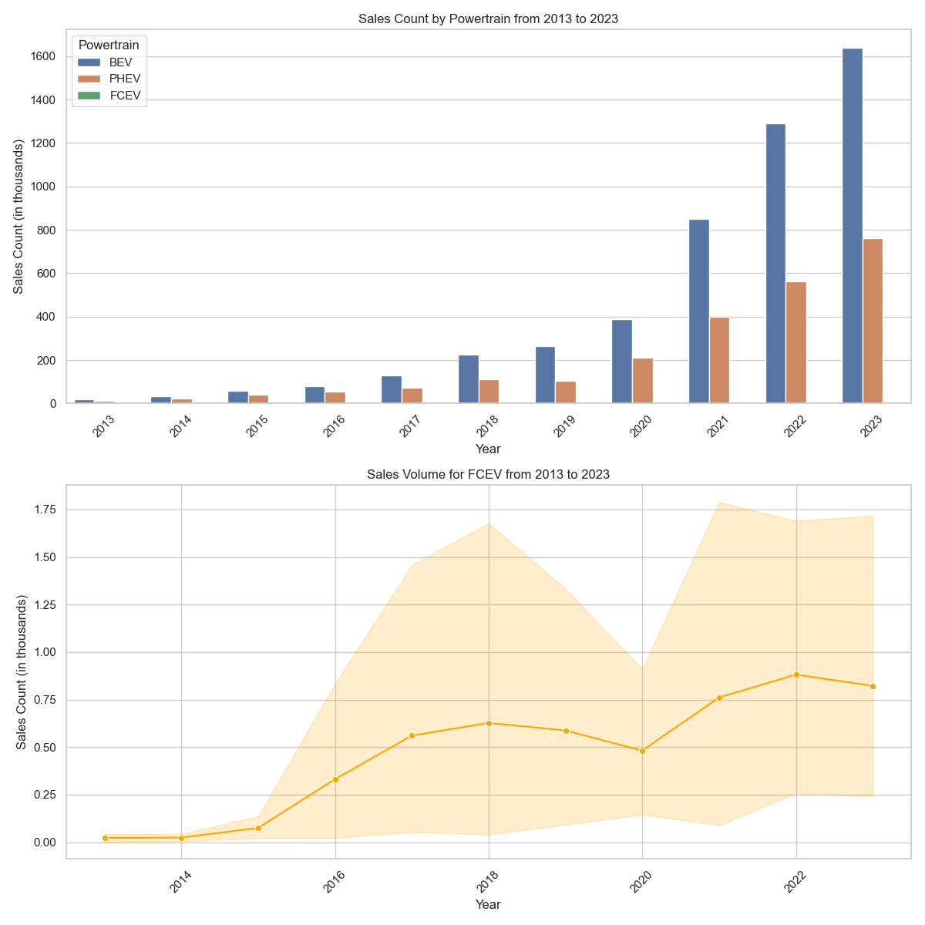
Analysis Page
The market shares of BEVs and PHEVs were comparable prior to 2017, although both were relatively small
The sales data from 2017 onwards reveals that BEVs constitute a significant proportion of the total electric vehicle market
However, sales of both BEVs and PHEVs are increasing worldwide and the need for charging infrastructure will continue to grow
The market for fuel cell electric vehicles has stayed small over the past ten years
The sale of FCEVs will not be affected by investment in charging infrastructure because FCEVs are not dependent on traditional charging methods

Slide 7
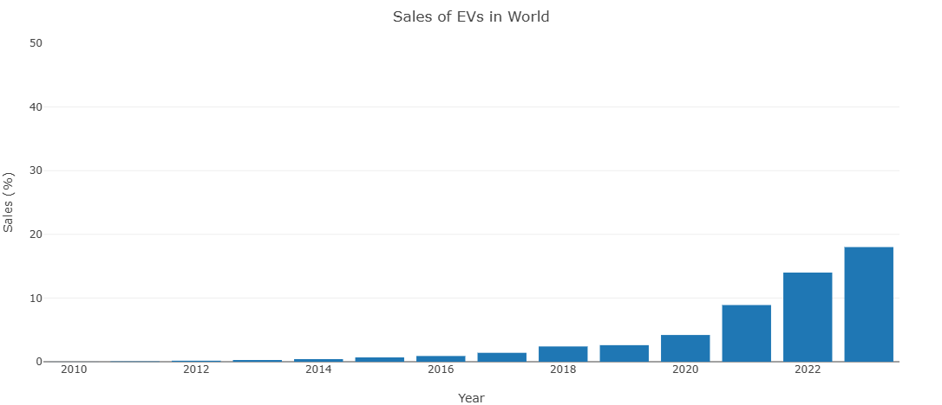
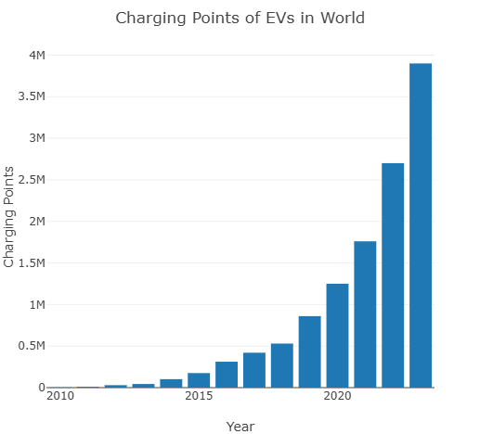
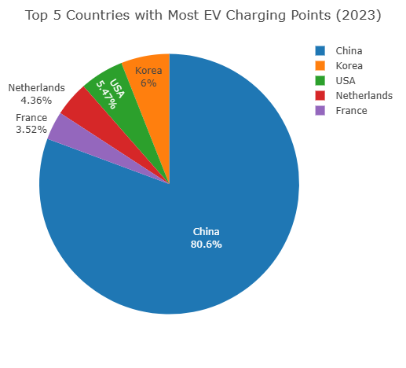
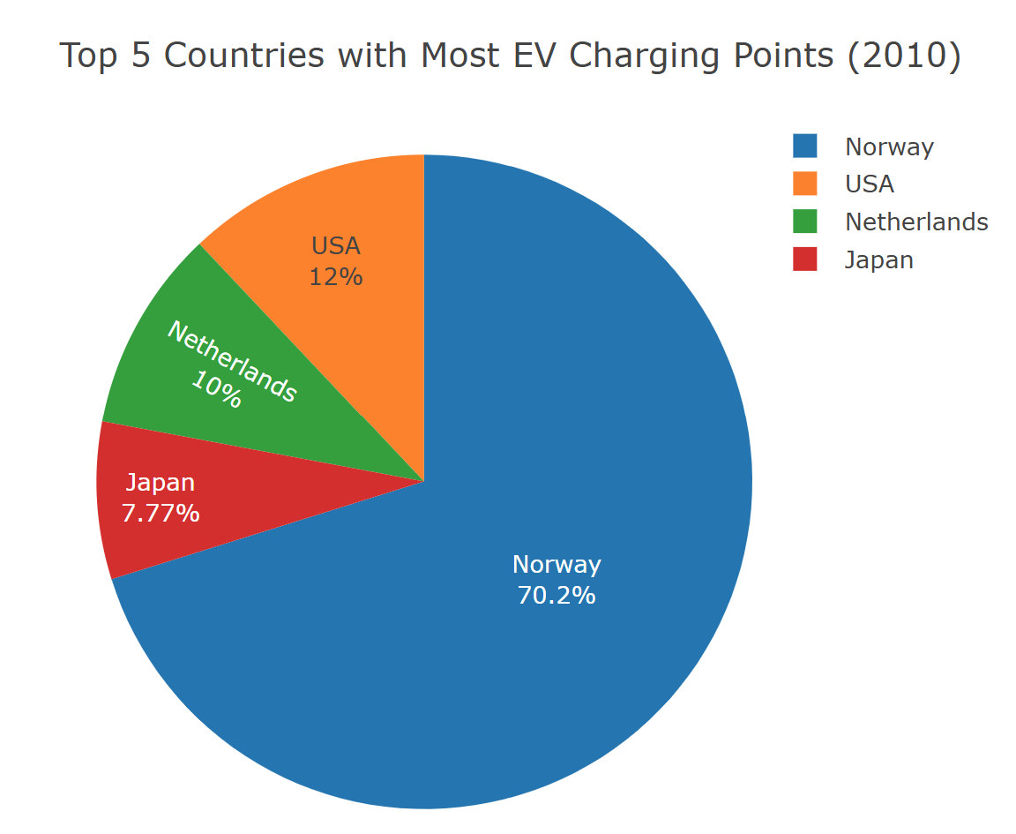
Analysis Page
Sales of electric vehicles have have gradually increased over the last decade, nearly 1 in every 5 cars sold worldwide was electric in 2023
Along with the increase in sales of electric cars, the number of charging points across the world have also increase to keep up with demand
Majority of growth in the electric car industry comes from the Chinese market. Making up 80% of all electric cars sold worldwide in 2023

Slide 8
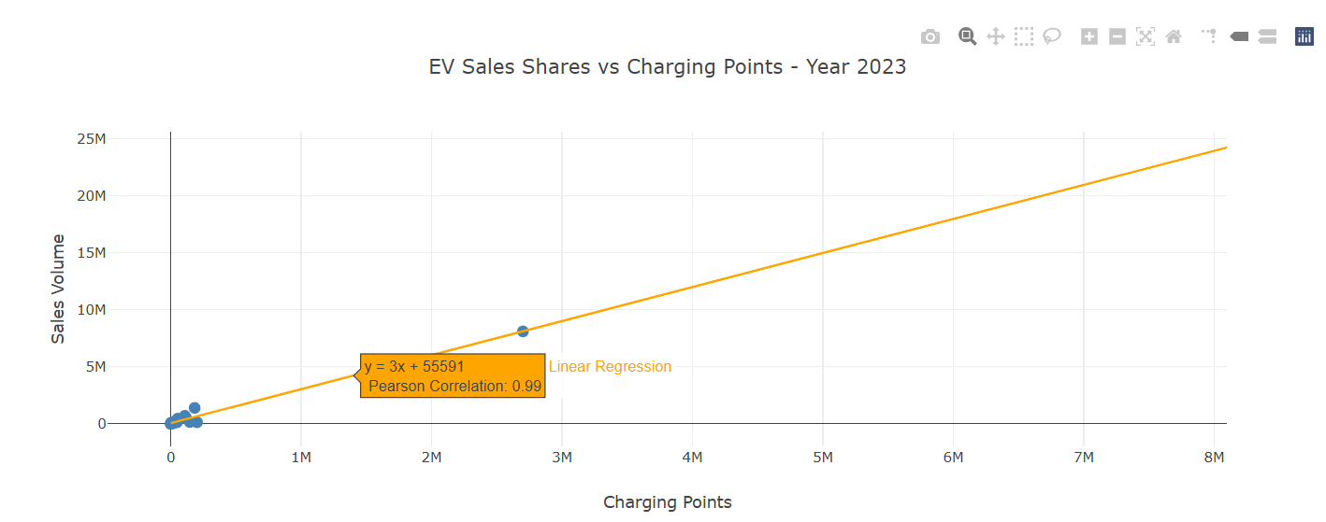
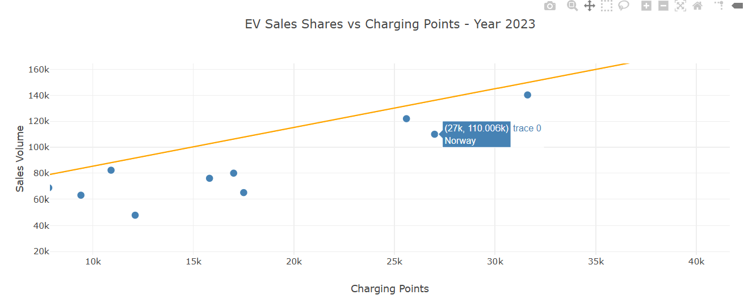
Analysis Page
China has 4 times as much EV sales compared to the US
Norway has the highest percent of cars sold as electric vehicles
The relationship between charging points and sales of EVs in 2023 has a positive strong correlation indicating that as charging points increases so does the EV sales
This is true for every year but the correlation gets weaker as you go more in the past
2011 has a moderate correlation and 2010 has a negatively correlation relationship

Slide 9
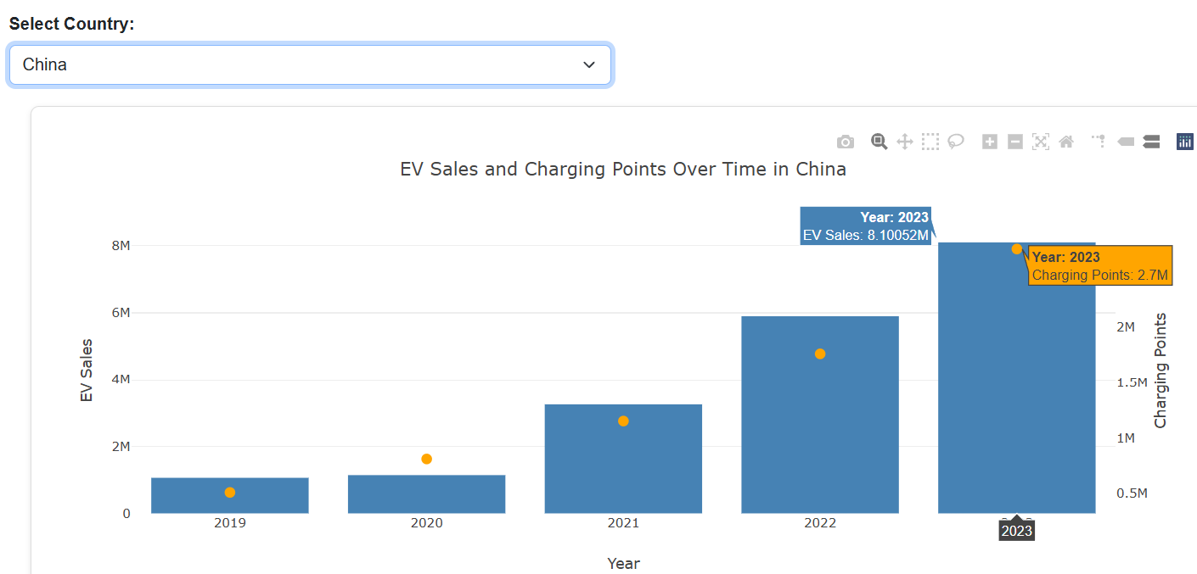
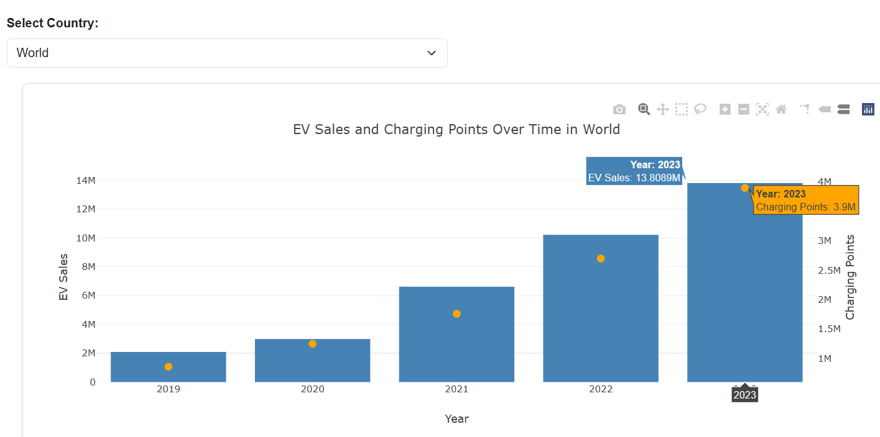
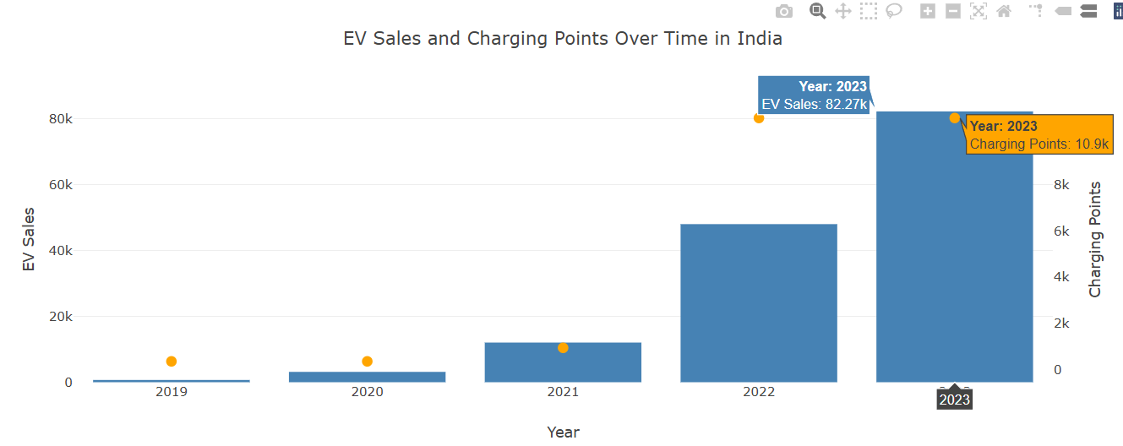
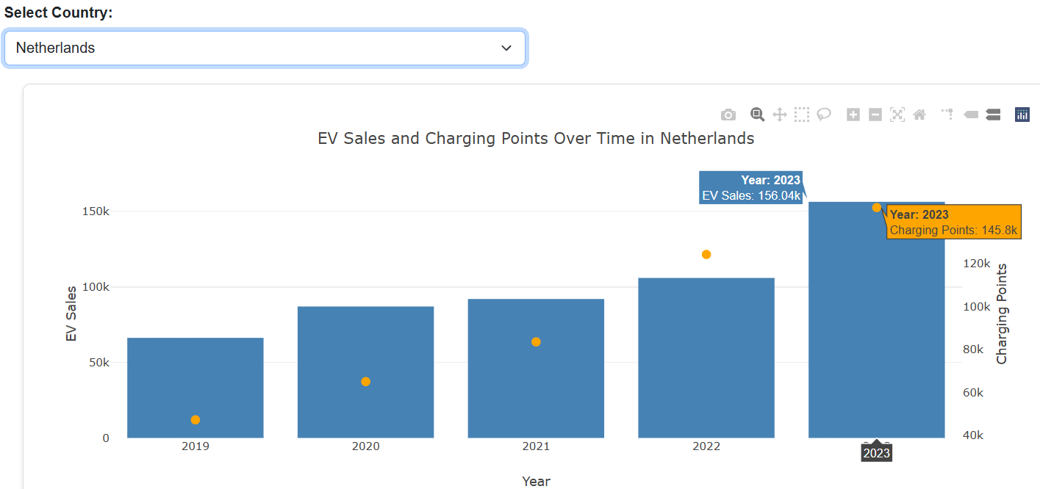
Analysis Page
Charging infrastructure seems to have a huge impact on adoption of EVs, in most countries.

Slide 10
Conclusion
Electric cars are on the rise worldwide with China leading the way, followed by Korea, USA, Netherlands and France
EV sales are impacted by increase in charging locations
While PHEV still remains steady in sales, BEVs are the most widely accepted powertrain, and FCEV have not gained any meaningful market share

Slide 11
References
Global EV outlook 2024 https://www.iea.org/reports/global-ev-outlook-2024/
Mckinsey articles https://www.mckinsey.com/featured-insights/mckinsey-explainers/what-is-an-ev
https://www.mckinsey.com/industries/automotive-and-assembly/our-insights/mckinsey-electric-vehicle-index-europe-cushions-a-global-plunge-in-ev-sales
US Department of Energyhttps://afdc.energy.gov/vehicles/fuel-cell#:~:text=Fuel%20cell%20electric%20vehicles%20

